Slide 1
© 2008 know today, live better tomorrow

Slide 2
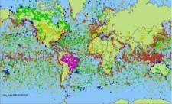
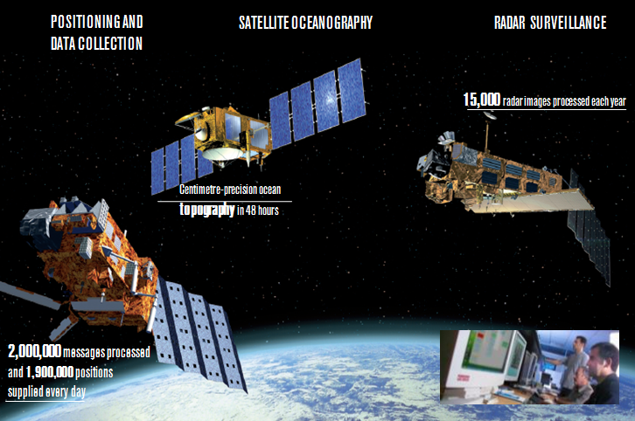
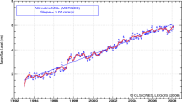
24/7
Receiving, processing, validating, distributing and archiving data
from approximately 80 instruments carried on almost 40 satellites
15,000 radar images processed each year
Centimetre-precision ocean
topography in 48 hours

Slide 3
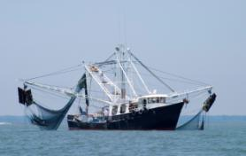
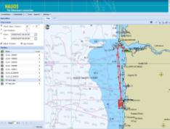
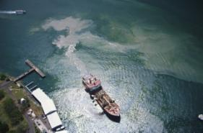
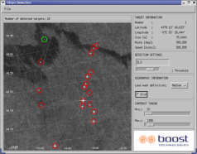
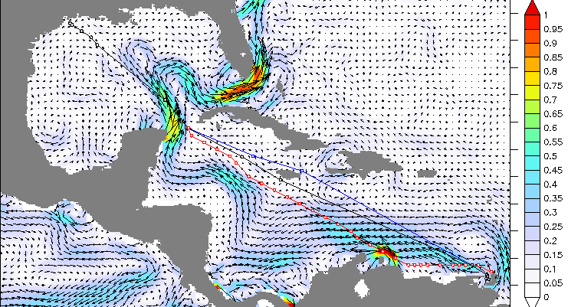
Providing services and applications
Tracking: tracking movable assets – merchant ships, tankers, fishing boats, sailing boats, offshore platforms, animals, etc.
Surveillance: detecting pollution, detecting illegal fishing boats, observing ocean conditions, etc.
Ocean conditions: maritime routing, ocean weather bulletins for oil rigs, etc.

Slide 4
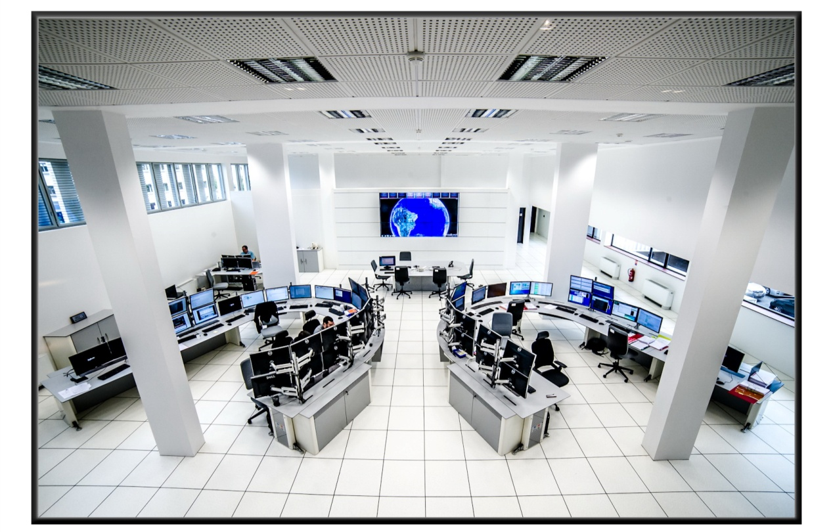
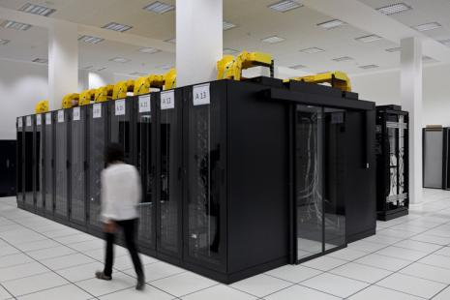
Data processing chain and operation center
Thanks to 3 processing centres in back-up, 2 in France (1 at French space agency) and 1 in Washington USA, CLS provides 99.5% system availability.

Slide 5
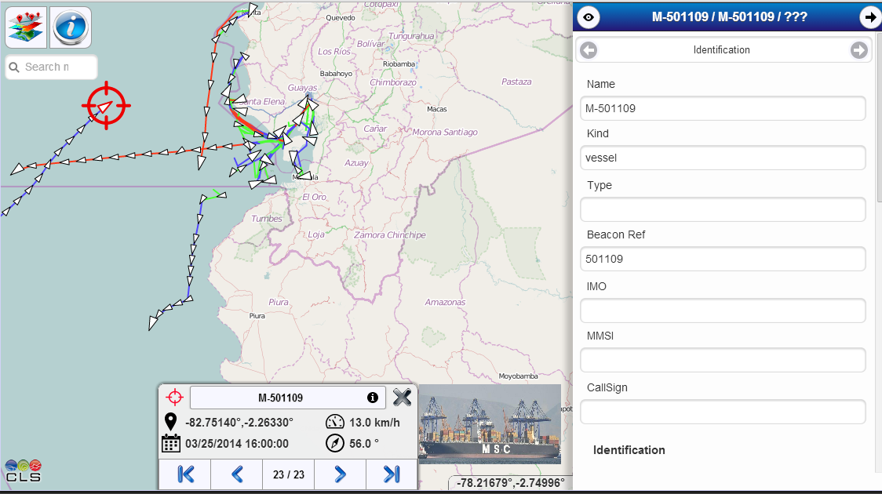
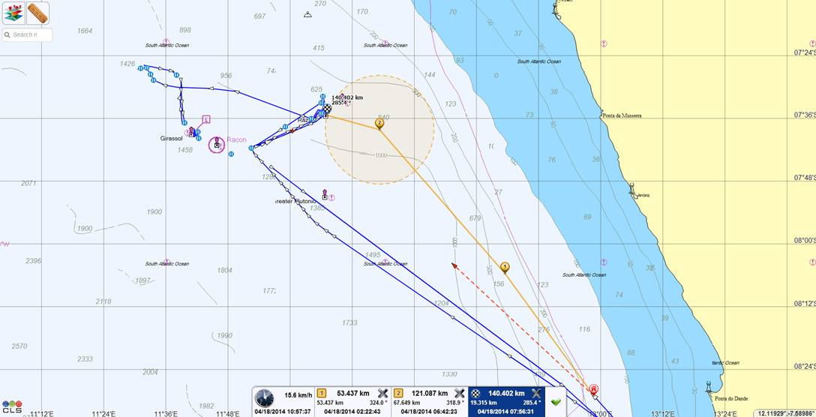
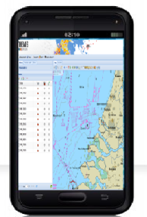
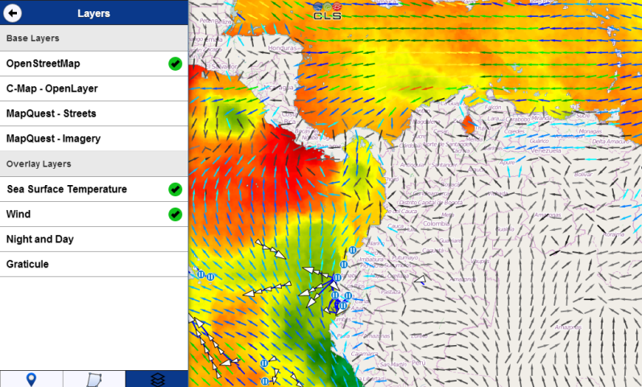
Web-based access -Fishweb
The FISH WEB maritime monitoring is a reliable tool that displays position reports from various satellite providers and includes advanced geo-fencing capabilities, alert monitoring and a variety of vessel management features.
Weather data and forecast

Slide 6
d
SATELLITE TERMINAL
© 2008 know today, live better tomorrow

Slide 7
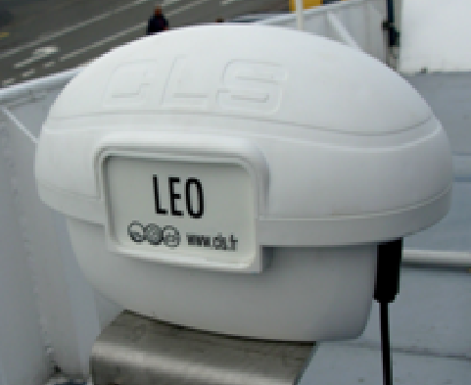
LEO : GLOBAL VMS + ERS SATELLITE TERMINAL
d
Real-time position reports (with speed and heading, date and time) Transmission interval between 5 minutes and 63 hours
Acquisition parameters geolocation with GPS:
Geographical position precision of the order of a few meters
Heading with a resolution of 1 °
Speed with a resolution of 0.5 knots
Acquisition interval between 5 minutes and 63 hours
Automatic transmission at regular intervals geo-location data, the parameters of the beacon and sensor data:
Dating
Parameters of geo-location
Technical status of the marker (flag intrusion, supply voltage, RSSI ...)
Sensor data
Transmission of event data and geo-location tag parameters
BENEFITS
Certified by European authorities
Global satellite tracking, logbook and email communication
Global Distress Alarm (A4 zone)
Geofencing Mode
Extendead battery life (10 days)
Internal memory, Up to 90 days data memory
2 Years warranty
Temperature :
operating temperature -20°C à +60°C
storage temperature de -25°C à +70°C
Compliant with EN60945:
DOME IP 67
Junction Box IP 54
© 2008 know today, live better tomorrow

Slide 8
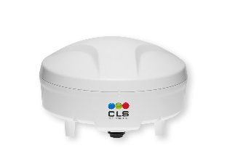
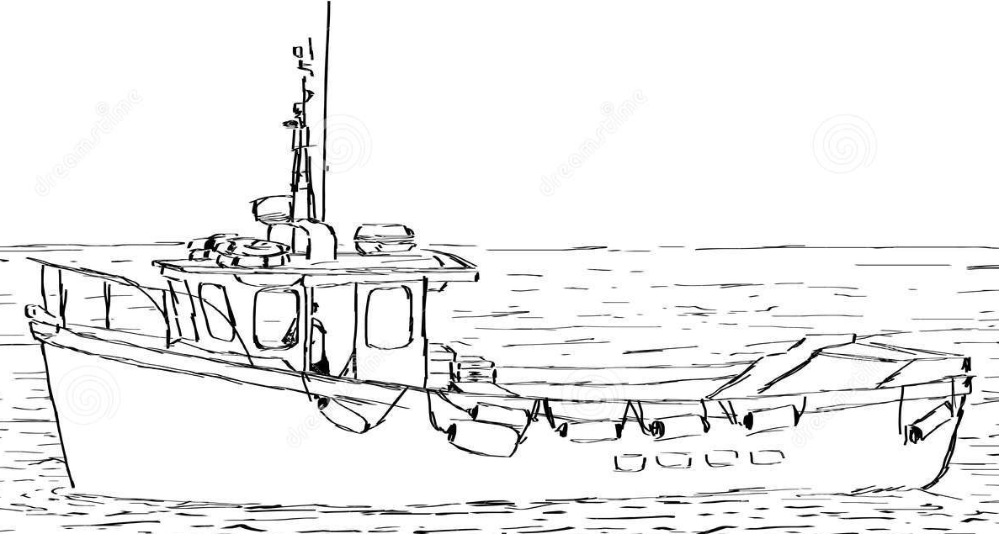
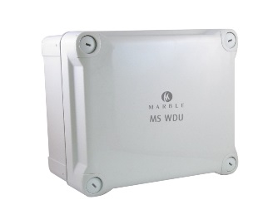
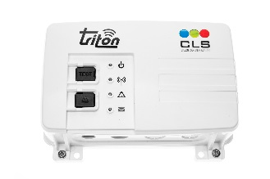
Satellite terminal
Junction box

Slide 9
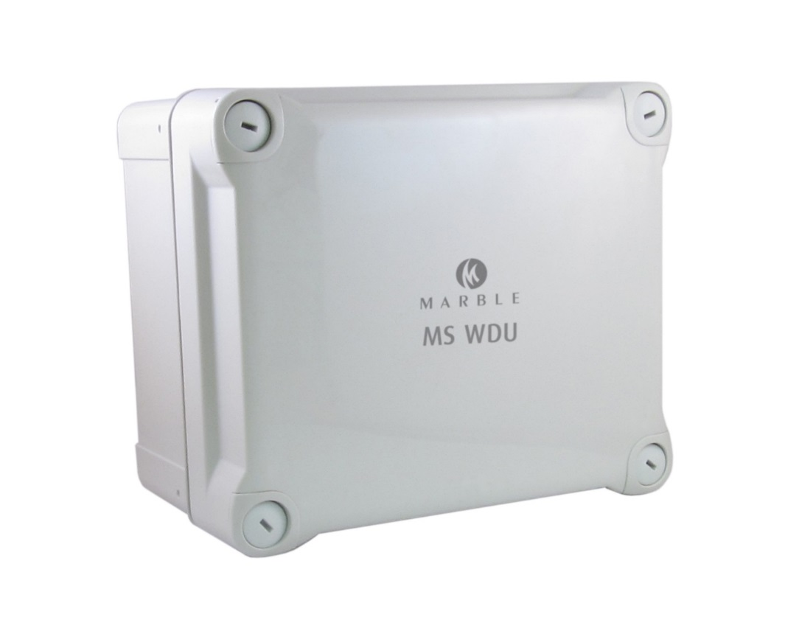
MS WDU
Garnalen visserij
1 MS WDU
4 Sensoren
4 Brackets

Slide 10
VMS + BLACKBOX + ERS
Dank voor uw aandacht
Maerten van Uggelen (Alphatron) en Stefan Meun-Visser (Marble)

